Slide 1
Updates
I’m still working on getting access to CourseWeb.
I’ve asked about the loaner program, getting mixes messages. I’ll follow up.

Slide 2
Platforms
INFSCI 1073/ TELCOM 2727

Slide 3
The Big Two
iOS
Android

Slide 4
The Big Two?
WebOS
Bada
iOS
Android
Windows Phone 8.1
BlackBerry
Firefox OS
MeeGo
Tizen
Ubuntu Phone

Slide 5
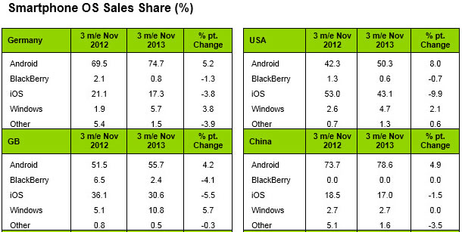
Who’s using what?

Slide 6
iOS
Objective-C
Pixel Perfect
Handful of Screens
API Limitations

Slide 7
Android
Relative Layouts
Many, many, many devices!
Operating System Lag
Open Platform

Slide 8
Mobile Web
Cross Platform
Many Similar Features
Local Storage Support
Location
OS Is Irrelevant?

Slide 9
iOS versions in the wild
1-2.x
3-4.x
5.0 & 5.1
6.0 & 6.1
7.0

Slide 10
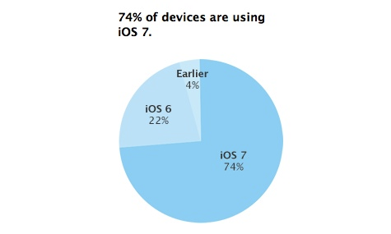
IOS usage as of Dec 1, 2013
http://appleinsider.com/articles/13/12/05/apple-pegs-ios-7-distribution-at-74-ios-6-at-22

Slide 11
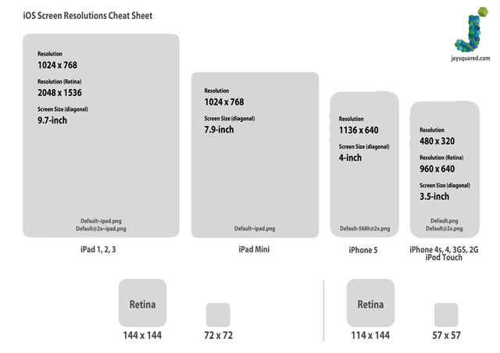
iOS Screens
http://www.jaysquared.com/2012/10/ios-screen-resolutions-cheat-sheet/

Slide 12
Android versions
2.0 Éclair
2.2 Froyo
2.3.3 Gingerbread
3.0 – Honeycomb
4.0 Ice Cream Sandwich
4.1 JellyBean
4.4 KitKat

Slide 13
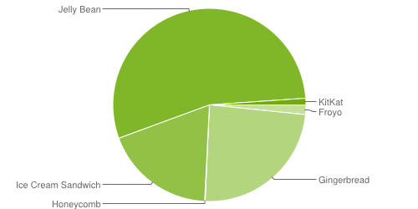
Android Usage by Dec 2, 2013
http://developer.android.com/about/dashboards/index.html

Slide 14
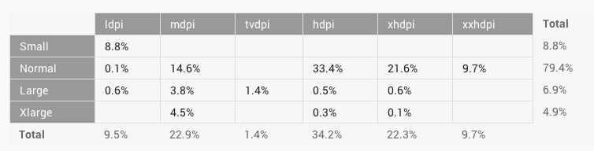
Android Screens
http://developer.android.com/about/dashboards/index.html

Slide 15
Not a Silver Bullet!
Browser Compatibility!
Offline capability?!
Native Look and Feel!
UX issues.

Slide 16
“Well technology X lets me run anywhere”

Slide 17
Biggest Industry Lie

Slide 18
Native Development

